Slide 1
Changing the Conversation
Andrea Whittaker. Ph.D.
Stanford University
September 2011

Slide 2
3 Big Ideas
Why performance assessment of beginning teachers? Why now?
What’s in it for us? Why make the investment?
What can it look like when we change the conversation?

Slide 3

Time to change
Time to change the conversation about the meaning of “good” teaching and how we assess it.

Slide 4

Higher Standards and
Bad Measures?
Notes:
If you are not at the table you end up on the menu!

Slide 5
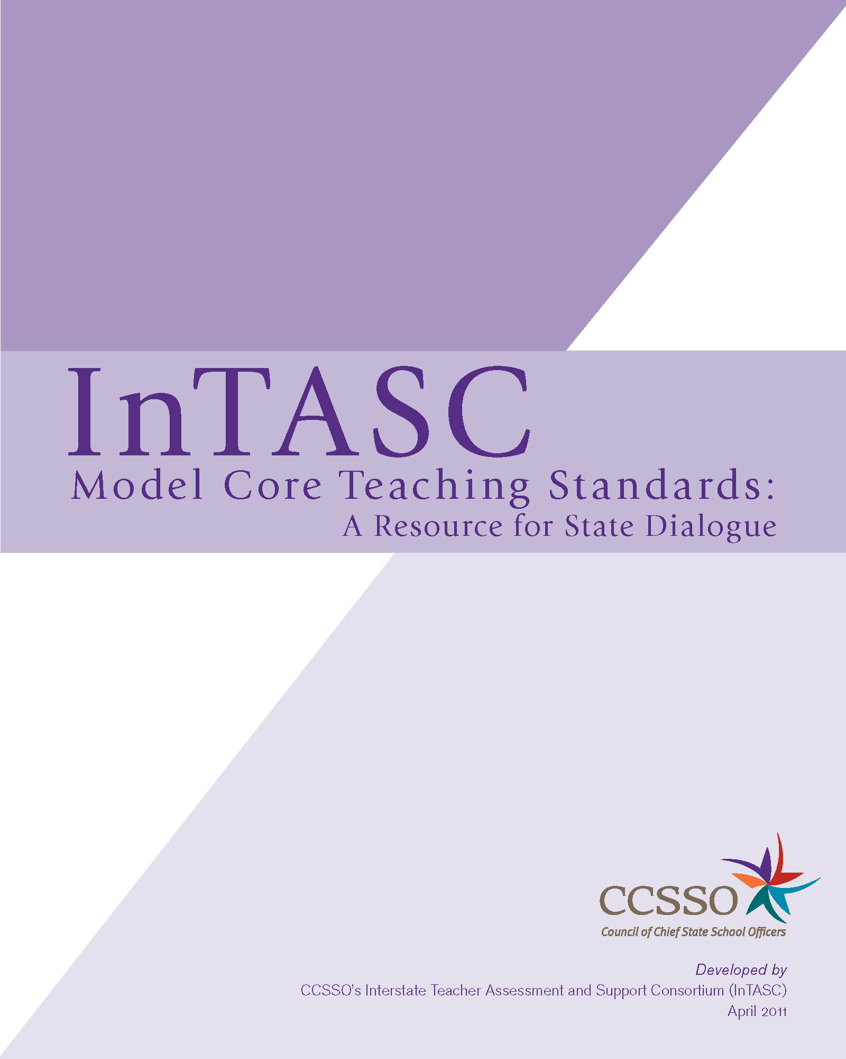





Why Now?
Blue Ribbon Panel –
10 Principles
PARCC and
Smarter Balance
Assessments
Notes:
Teacher education institutions find ourselves sitting at the center (some would say a target) of a national conversation about:
Raising and measuring student achievement
Evaluating Teacher “Effectiveness”
Improving Preparation and induction
Evaluating teacher preparation

Slide 6
Accountability reframed
…as professional responsibility
How can we gather and use evidence of the qualities of teaching performance that inspire, engage, and sustain students as learners – to improve teaching and teacher preparation?
Notes:
The anchoring question for TPAC is
How can we gather and use evidence of the qualities of teaching performance that inspire, engage, and sustain students as learners – to improve teaching and teacher preparation?
Then use this evidence to set a clear vision and shared language for teaching practice, and coach candidates’ development around these qualities.

Slide 7
Where TPAC fits in
TPAC is working to develop and implement at scale a way of assessing teaching that…
Provides evidence of teaching effectiveness,
Supports teacher preparation program improvement
Informs policy makers about qualities of teaching associated with student learning.
TPAC is ONE example of an assessment system that is designed to leverage the alignment of policies and support program renewal.
Notes:
TPAC is working to develop and implement at scale a way of assessing teaching that
provides evidence of teaching effectiveness, and
supports teacher preparation program improvement.
TPAC is ONE example of an assessment system that is designed to leverage the alignment of policies and support program renewal.
Over the next 25 minutes or so, I’d like you to think about the TPAC assessment model as a tool that works to advance teaching practice and student learning, and is coordinated within a set of other policy levers – like the Common Core, InTASC

Slide 8
Design Principles for
Educative Assessment
Discipline specific and embedded in curriculum
Student Centered: Examines teaching practice in relationship to student learning
Analytic: Provides feedback and support along targeted dimensions.
Integrative: maintains the complexity of teaching
Affords complex view of teaching based on multiple measures

Slide 9
Multiple Measures Assessment System
Embedded Signature Assessments
TPAC Capstone
Assessment
Integration of:
Planning
Instruction
Assessment
Analysis of Teaching
with attention to Academic Language
Child Case Studies
Analyses of Student Learning
Curriculum/Teaching Analyses
Observation/Supervisory Evaluation & Feedback
Notes:
9
So the TPA itself draws on multiple measures AND is designed to serve as a capstone event WITHIN a system of other measures. The other assessments, which are described as Embedded Signature Assessments, may include a number of different kinds of assignments, and vary across programs depending on specific program goals or values.
The next slide unpacks the capstone assessment…

Slide 10
Targeted Competencies
PLANNING
Planning for content understandings
Using knowledge of students to inform teaching
Planning assessments to monitor and support student learning
INSTRUCTION
Engaging students in learning
Deepening student learning during instruction
ASSESSMENT
Analyzing student work
Using feedback to guide further learning
Using assessment to inform instruction
REFLECTION
Analyzing Teaching Effectiveness
ACADEMIC LANGUAGE
Identifying Language Demands
Supporting students’ academic language development
Evidence of language use

Slide 11
Why bother?
This too shall pass…
We are already doing something like this
Our candidates are already well prepared
The testing company will take over
We don’t have the resources or time
It doesn’t measure what we care about

Slide 12

Compliance?
Notes:
It’s a state mandate so we have to it. But we’ll just tweak what we do so that candidates can get through it – CA had a mandate too and some of us chose another path…

Slide 13

Inquiry?
Notes:
What’s another way? How can we ensure that we take this mandate and make it educative and meaningful to US, our candidates and our K-12 partners?

Slide 14
“Cultures of Evidence”
From Peck and McDonald’s Study of PACT Implementation (2011)
  Critical and collegial conversations about PACT adoption
  Inquiry and program improvement as motivational orientation, not compliance
  Affirmed values and identity of programs
  Strategic inclusion of faculty in examining cases of candidate performance at regularly scheduled events
Notes:
Survey of all 32 PACT institutions, interviews with about half and 3 case studies.

Slide 15
Transformative Practices
When inquiry rather than compliance drives implementation = transformation
Data used to identify gaps in curriculum (e.g. assessment, SPE)
Increased expectation of evidence of K-8 student learning
Focused reflection, analytic writing, & data use (candidates)
Robust data management

Slide 16
Accountability reframed
…as professional responsibility
How can we gather and use evidence of the qualities of teaching performance that
• inspire, engage, and sustain students as learners
• improve teaching and teacher preparation
• set a clear vision and shared language for teaching practice
• coach candidates’ development around these qualities.
Notes:
The anchoring question for TPAC is
How can we gather and use evidence of the qualities of teaching performance that inspire, engage, and sustain students as learners – to improve teaching and teacher preparation?
Then use this evidence to set a clear vision and shared language for teaching practice, and coach candidates’ development around these qualities.

Slide 17
-- Prospective teacher
I used to look at assessment as a way to assess kids. And this is the first time, through PACT, that I realized that in assessing, you should really primarily be assessing yourself as a teacher…What evidence do you have that the students picked up on your scaffolding, picked up on the academic language, picked up on the advanced concepts or the medium concepts?...Instead of “Does this child know X?,” the question is “Have I provided adequate scaffolding for this child to be able to do X and what is the evidence showing me? How effective was my teaching?” And so, you end up assessing more yourself than assessing the kids. So, I mean, you do assess the kids, but it’s really the thing that you do together…

Slide 18
-- Teacher education faculty member
As I have done the scoring, I have noticed pieces that I need to go back and make more explicit within my own coursework. For example, I really felt that I needed to do more specifics about how do you actually modify a lesson and how do you know what you are teaching to, especially if we have people working within a more structured program. And so, this year I spent a lot more time focusing on struggling readers.

Slide 19
-- Program Administrator
So what it has also provided, then, is a coherence to our program. It’s given us a common dialogue around which to all talk about our, the work of our students. And it’s almost kind of de-siloed people’s work, because we’ve been required to share our work. And we’ve always done that before, but the PACT has given us a center around which to focus our conversations because…it’s sufficiently broad enough with the act of teaching yet diagnostic enough that regardless of what discipline you teach, it gives you insight into some aspect of what you were already doing in your classroom.

Slide 20
Our Larger Purpose #1
to create program coherence and relevance for our students rather than simply complying with our external accrediting agencies.

Slide 21
Larger Purpose #2
to plan a process whereby faculty would experience the new assessment system implementation process not as a another layer of “one more thing to do,” but rather as the enactment of an inquiry process where they examined their practice related to what students actually learned given a reliable and valid performance assessment

Slide 22
Larger Purpose #3
to use the results with the end goal of program improvement.

Slide 23
An Inquiry Approach
Theory of Action—Study the ways in which this tool can provide a significant source of data to inform and improve our program.
• Reframed standing meetings, committees, department retreats as our venue to create a “professional learning community”

Slide 24
“Unpacking” PACT
2006-07
Mapped expectations of each portfolio task and rubric dimensions to existing experiences and assignments across courses
PACT language was “operationalized” through activity, dialogue and discussion
  “Intellectual Engagement”
  Academic Language
Determined areas for further scaffolding

Slide 25
Curriculum Mapping
What are candidates asked to do? In what ways does this look familiar or align with our own assignments, assessments, course activities and field experience expectations? | What evidence do we have that our candidates do this well?
What is new/different? What might challenge our students? How would this challenge provide added value in their preparation? | Which valued program outcomes are left out (or treated superficially) and need to be assessed other ways?

Slide 26
“Mock Scoring”
Reviewed state level benchmark papers to familiarize ourselves with the rubrics, performance levels and evidence of student performance
Read SJSU students’ TPAs to identify our students’ strengths and struggles
Used for program evaluation not initially for high-stakes evaluation for individual candidates

Slide 27
SJSU Outcomes
Assessment system matrix
Signature assessments by course
Links to Standards
Knowledge base continuum
Purpose/consequences

Slide 28
Assessment System
Addresses full range of desired outcomes for candidates (required standards and program specific)
Includes formative, transition and summative tools/processes
Formative processes scaffold naturally for summative assessment and are curriculum embedded
Consider which assessments are “consequential” and how data will be used
Notes:
Show matrix on desk top

Slide 29
Embedded Assessments
Start with curriculum map
Examine existing course assignments and candidate performance data
Strengthen assignments to scaffold summative outcomes
  Consider using TPAC rubrics (or modify for formative use)
Ensure all valued program outcomes and associated assessments have “status”

Slide 30
Academic Language
Functions/forms of language and vocabulary
needed for subject matter learning
Year long professional development for faculty and field supervisors
Revised and re-sequenced “language acquisition course” as prerequisite for student teaching
Developed ESA – adapting curriculum materials based on language demands and support for AL development

Slide 31
Critical decisions
Build faculty consensus about valued outcomes
Make decisions based on candidate performance data
Sequence ESAs (and rubric criteria/levels) in ways that reflect candidate development
Allow faculty autonomy in instruction supporting ESAs
Standardize only what is necessary!

Slide 32
Final Thoughts…
Maintain the focus on program outcomes for improved program quality and effective teaching
  NOT for success on TPA
  NOT as compliance with Ohio mandate
Engage inquiry within a professional learning community at the local, state and national levels.
To inform policy and program renewal not merely comply

Slide 33

Change the conversation

Slide 34

or

Slide 35
Closing thought
“Our purpose is to have all of the parties who should and must be involved in creating and enacting teaching policy, work together and understand each other in the support of students. We all have a role in restoring the healthy balance public education, and all our children, require. Psychometric rules must at times be reinvented in the interest of children. Simple and quick political solutions must at times be tempered in the interest of children. The tendency to impose mechanistic models on the complex and holistic process of teaching and learning must cease in the interest of children. Finally, as teacher educators we must think through our own practice and our own involvement in policy at all levels of the educational system. We must take hard looks at our own responsibilities towards the profession in the interest of children.” (J.Snyder, 2001)

