Slide 1
Valid and Reliable Instruments for Educator Preparation Programs (VARI-EPP)
Student Teaching Form
(VE-ST Form)
Implementation Team OCTEO Update
Wednesday, October 28 2:30 – 3:30 PM
VARI-EPP Coordination Team: Erica Brownstein, Kristall Day, and Carolyn Kaplan
Notes:
ERICA

Slide 2
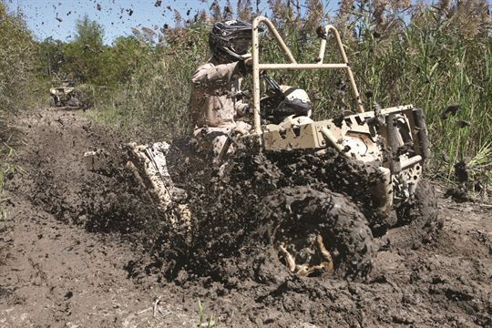
VE-ST Form: The ATV of Instruments
Notes:
ERICA
All Terrain Vehicle
Sources: http://media.dma.mil
http://www.mykemptvillenow.com
https://www.expedia.com

Slide 3
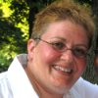


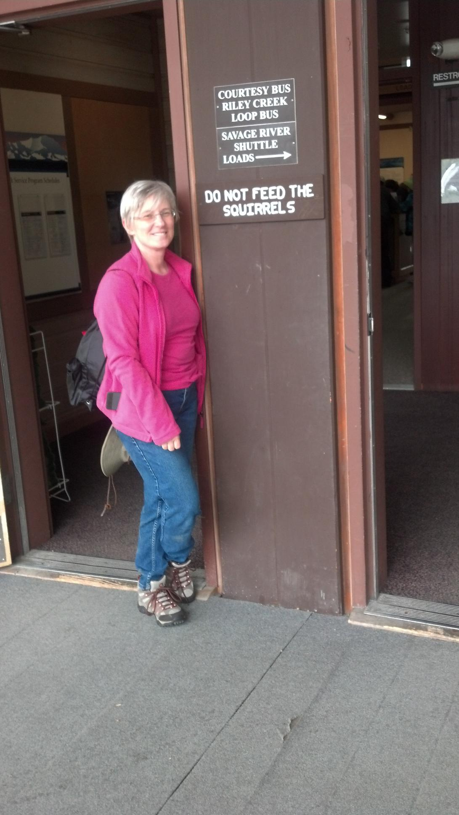
History of Valid and Reliable Instruments Project
Notes:
Inviting people to join our adventure…

Slide 4
Professional Standards
(InTASC)
Research
(Ball, Marzano, etc.)
OSTP
VE-ST Form
Measures ST Performance
Enables
Data
Formative assmt.
- for student teachers
Prog. improvement
- Availability and program use of comparison mean scores (aggregated from all users)
Used for
The VE-ST Form Process
VARI-EPP Partners role in the process
Notes:
ERICA

Slide 5
What data are collected?
Data
- VE-ST Consensus Score
- edTPA scores
- OAE scores
- Demographics
All IHEs
IRR IHEs
Data plus
- three observations - IRR Supervisor final evaluation
Notes:
ERICA

Slide 6
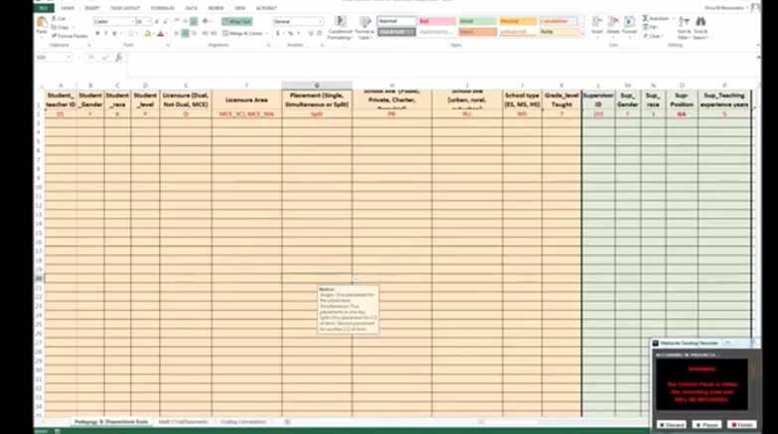
28 institutions
At least 10 institutions collecting data in fall
  Should have received a data collection spreadsheet & instructions
Notes:
ERICA

Slide 7
Project Timeline
Summer 2014
Instrument Development
Spring 2015
Pilot Implementation
June 2015
July 2015
Summer 2015
August 2015 to May 2016
2015- 2016
Data Analysis: Implementation, Feedback, Content Validity
January 2016
Instrument Revision
Training Module 2.0 Development: For supervisor use of forms
Implementation of VE-ST Form Version Two: Implementation Team
Data Analysis
Notes:
CAROLYN

Slide 8
What to expect for remainder of year
November 2015
Second review by content experts
Early December 2015
Release of training version 3.0
Late December 2015
Winter 2016
Selection of IRR IHEs
June 2016
Submit form to CAEP for advanced rubric evaluation
Spring data due to Ohio State for analysis
IRR funds dispensed to IRR supervisors after data submission
February 2016
Updated data collection form and webinar
Early January
Training webinar for IRR IHEs
January 4, 2016
Fall data due to Ohio State for analysis
Request for IRR demographics
Summer 2016
Release of training version 4.0
Notes:
CAROLYN

Slide 9
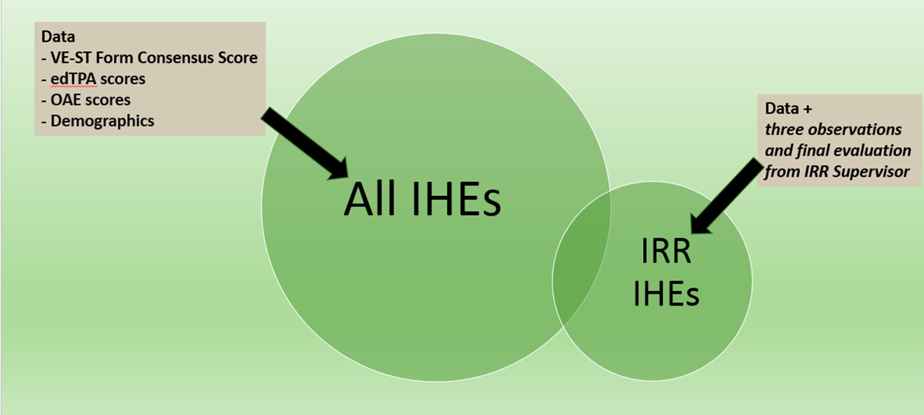
Subset of IHEs
Inter-Rater Reliability (IRR) Study
Different (and in addition to) statistical analyses
Spring term only
Two supervisors will observe the same student teacher
  Supervisor: University-assigned supervisor, completes duties as assigned, completes VARI-EPP form as formative and summative
  IRR Supervisor: A minimum of 3 observations, completes VARI-EPP form as summative
    IRR Supervisor receives $200
  If chosen to be part of the IRR study, the institution will receive
    A spreadsheet with designated columns for data collection
    Detailed instructions and webinar for how to complete the study
Notes:
KRISTALL
(This is what you said before for the webinar)
The second big component of the project includes inter-rater reliability studies. This is different than the analyses discussed on the previous slide and there are several additional steps for this part of the project. Not all institutions will be participating in this part of the study. The funding we have available to support this part of the study is limited; therefore, we may not be able to include everyone who is interested. We hope to include a variety of institutions and programs so that our data are more representative of the total population.
The general procedures for this part of the study include the following steps. First, you will identify a group who is willing to participate. This means the student teacher, the assigned supervisor, and the inter-rater supervisor have all agreed to be in the study and have signed the appropriate consents. In addition to these individuals providing consent, you will also need approval from the mentor teacher and the school. A conversation with the mentor teacher explaining the study should occur and you should obtain a letter of support from the building principal. Once you have IRB approval, we will provide the consent documents and templates for the letters of support.
Once all of the appropriate permissions have been obtained, the University Supervisor (the supervisor who was officially assigned to the student teacher) will follow the procedures that are typical to the institution. For example, if your institution requires the supervisor to observe 6 times, the supervisor will observe 6 times. If your institution requires completion of a narrative feedback form during each visit, the university supervisor will use that form. The only difference is that the university supervisor will complete the VARI-EPP form as a formative (midterm) and summative (final) assessment. It is critical that we have a record of the university supervisor’s independent ratings in addition to the consensus scores.
The IRR Supervisor, or the inter-rater supervisor, will observe the student teacher a minimum of 3 times. They can complete any forms the program uses as well, but at minimum they are required to complete the VARI-EPP form as a summative evaluation based on their 3 observations. Again, it is critical that we have the independent ratings for the supervisors so that they can be compared. The IRR Supervisor is not required to debrief with the student teacher and mentor teacher, but they can if the program chooses to do this. The IRR Supervisor should not observe at the same time as University supervisor and the two supervisors should not discuss the student teacher’s ratings and progress. The IRR Supervisor will not be part of the three-way conferences for the midterm and final and IRR supervisor will not assign any grades for the student teacher.
IRR Supervisor receives the $200 incentive for participating in the study. The university-assigned supervisor does not receive an incentive because they are not doing additional work.
Once you have IRB approval and you have been contacted to participate in the Inter-rater study, we will provide data collection tools for this portion of the study as well.
Before turning back to Erica to discuss the form, are there any questions about the research?

Slide 10
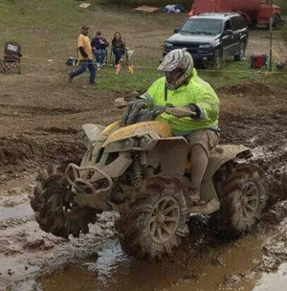
IRB Update
Many IHEs have been approved to begin
Non-FWA IHEs will hear from OSU IRB soon
  NIH Training required
If unsure, please contact Kristall Day (day.368@osu.edu)
Notes:
KRISTALL

Slide 11
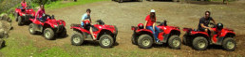
Notes:
Erica: The form has been linked to CAEP, InTASC and OSTP. We have moved away from the term “alignment” because we are not trying to say the form has the breadth and depth of the standard, but does have linkages.

Slide 12

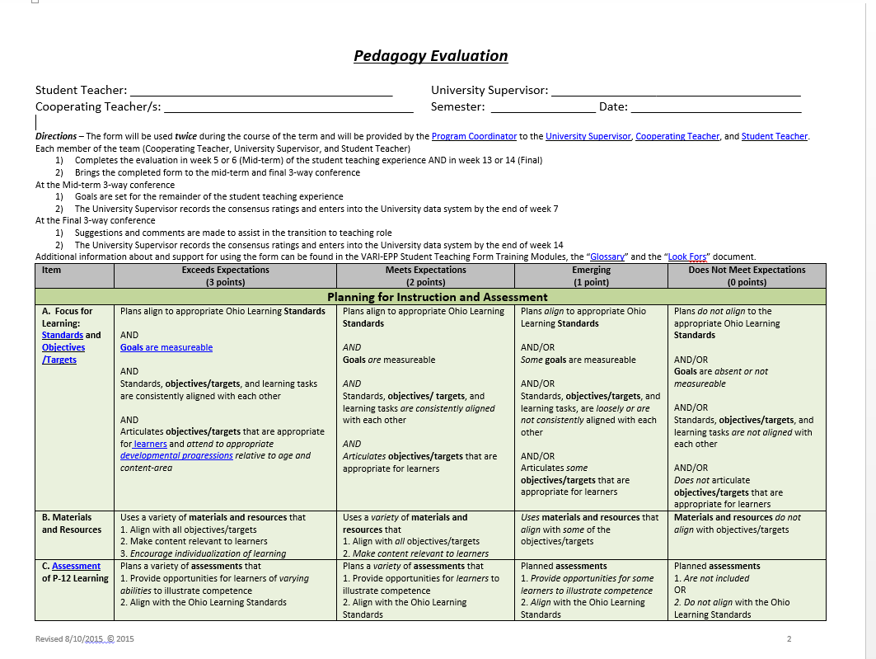

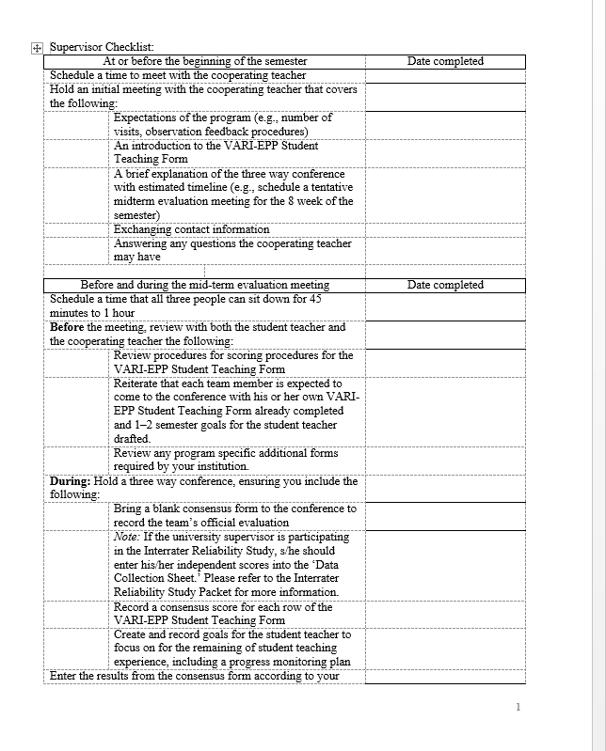
Tools Available to VARI-EPP Partners
Two-page project description for interested stakeholders, administrators, etc.
Supervisor Checklist
The Form
The ‘Look Fors’ Document
Consensus Form for conference
Notes:
ERICA – Solicit any partners to speak about the tools they have been using

Slide 13
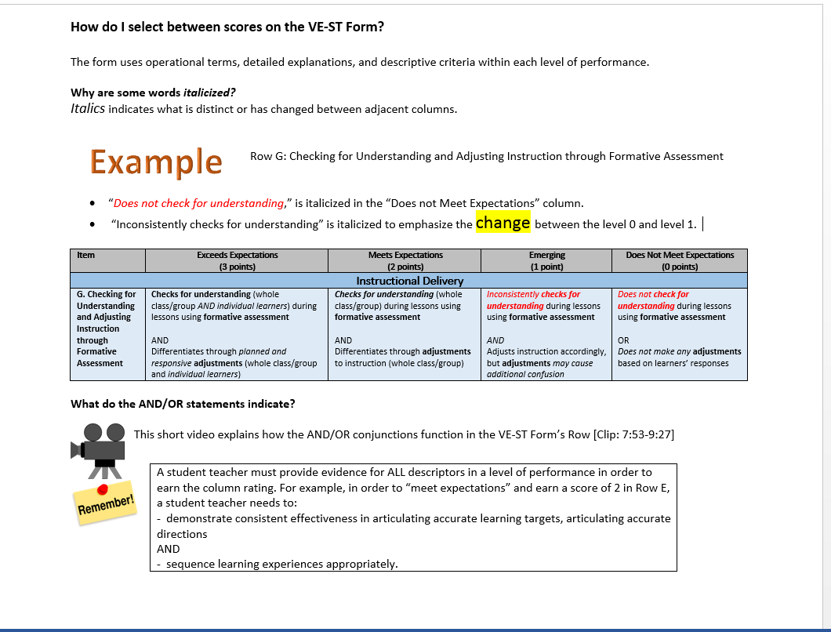
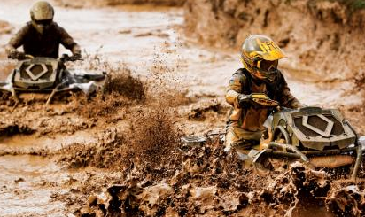
Thank you for your patience…
With the rollout of Training 2.0
  Feedback from supervisors informed revisions
Version 3.0 will be available in early December (or earlier)
  May need to enlist assistance of other institutions with other LMSs
    We are investigating how to simplify the use of Training Module 3.0 in other systems
Notes:
CAROLYN

Slide 14


FAQ
What to do if my students have multiple placements?
What do I use for ongoing observation?
  Isn’t the VE-ST Form an observation tool?
Are institutions developing or going to develop their own cut scores?
Notes:
ERICA
Source: https://openclipart.org/detail/213531/icon-faq

Slide 15
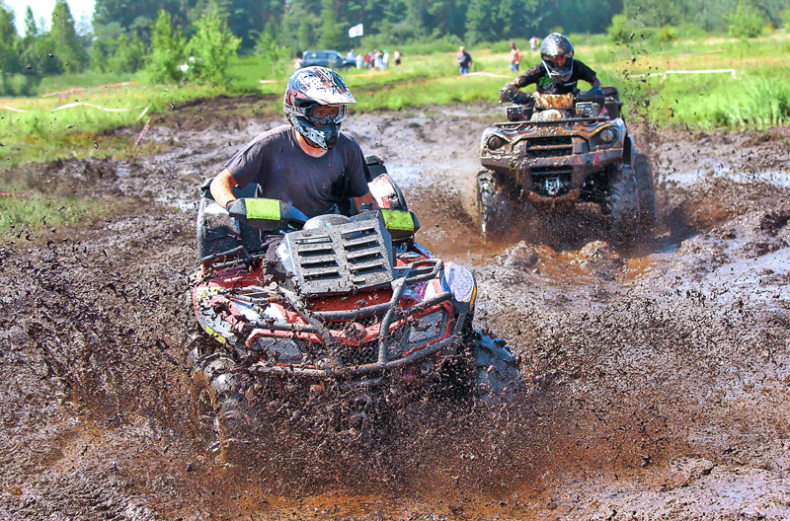
Discussion Questions
In small groups, please discuss
  Why participate?
  What are the obstacles?
  What would you like to share?
  What is working? Not working?
RECONVENE
  Group reporting
Questions? Comments?
  Project
  Process
  Future
Notes:
ERICA

Slide 16
Current Partners: We need your help!
Development of Assessment Questions for Training Version 3.0
  Questions encouraging trainees to examine form/ ‘Look Fors’ document
  Due by November 23
  For example:
  For more information, and to volunteer, please contact Carolyn (kaplan.169@osu.edu)
Notes:
CAROLYN

Slide 17
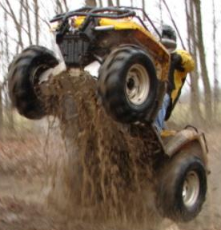
It’s great to be in the same room!!
If you have any questions AT ANY TIME, feel free to contact:
Name | Email | Phone | Topic
Erica Brownstein | Brownstein.2@osu.edu | (614) 292-1414 | “Big Picture” Project Questions, Rubric Questions
Kristall Day | Day.368@osu.edu | (614) 292-5044 | IRB, Data Collection, Timeline
Carolyn Kaplan | Kaplan.169@osu.edu | (614) 292-2581 | Online Training Module, Data Collection, Timeline
James Yao | Yao.298@osu.edu | (614) 292-2581 | Data Collection
Notes:
ERICA

Slide 18
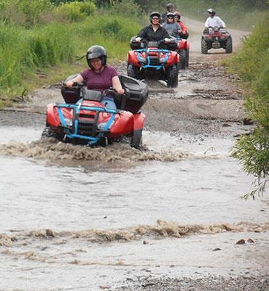
And onward we go!
Notes:
ERICA

