Slide 1
Creating & Sustaining Trauma Informed Schools
A Paradigm Shift for 21st Century Schools
Tim Callahan, Psy.D.
Clinical Psychologist
Director of Mental Health Services
The Greene ESC

Slide 3
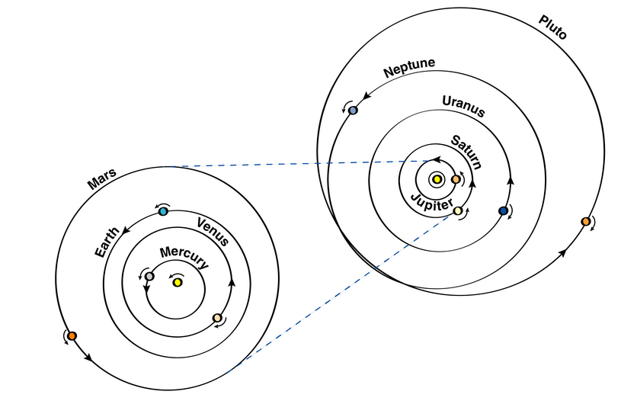

Slide 5
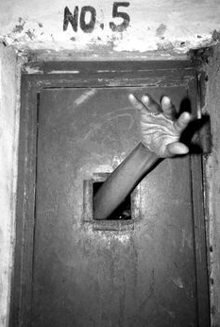
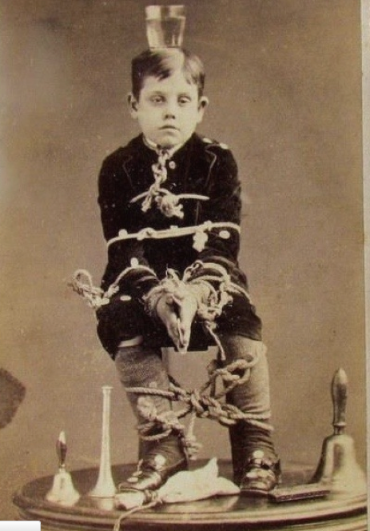
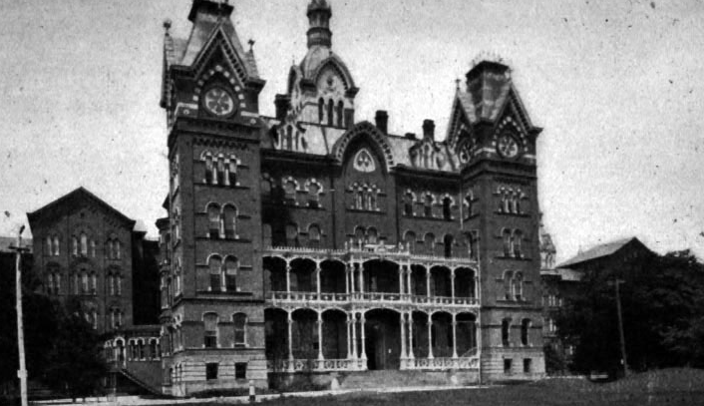
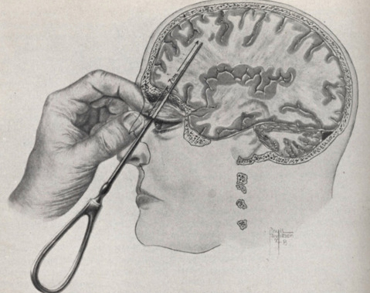

Slide 6
Prevalent & Pervasive
3 million children maltreated annually
1 in 4 girls/1in 6 boys sexually abused each year
71% of children exposed to violence annually
3-10 million children witnessed domestic violence
94% of children in juvenile justice have trauma history
40-80% of children experienced bullying at some time
75% of all Child Protection reports for neglect
Birth to age one: highest for neglect

Slide 7
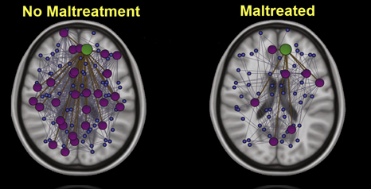

Slide 8
Executive Functioning: Prepare For Future
Stop & Think BEFORE You Act
Use Hindsight & Foresight to:
Anticipate the likely future so you can:
Prepare for that future so you can:
More effectively manage yourself across time
Reciprocal & Cooperative Interactions
Attend to Your Long-Term Welfare
Delay Gratification

Slide 9
Components
Activation, Arousal & Effort
Controlling Emotions
Shifting, Inhibiting, Splitting & Sustaining
Working Memory & Recall, Multi-tasking
Organizing & Planning Ahead
Self Monitoring
Internalized Language
HOT & COOL Executive Functioning

Slide 12
Adapting to Threat

Slide 14
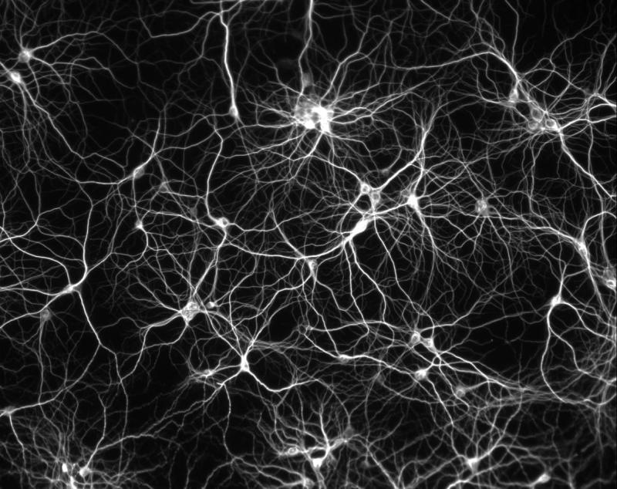
Notes:
14
Health=Regulation=Brain Health=Connections→
Connections=Stimulation/Rest while anchored to Trustworthy Adult with support and praise
Ongoing interaction between inherent features and environmental influences over time and through developmental windows/stages

Slide 17
Engage the Brain
Engage the Emotional Centers: Meaning & Relevance
“HOT” Executive Functioning and “COOL” EF
Hot Requires Exposure, Practice, Rehearsal in Safe Place
S.C.O.R.E.
SUCCESS: Need for Mastery, Micro-Successes
CURIOSITY: Need to Learn & Understand
ORIGINALITY: Need for Self Expression
RELATIONSHIPS: Need for Involvement with Others
ENERGY

Slide 18
National Research Council & Institute of Medicine Report 2009:
“Substantial Interrelationship Among Social, Emotional & Behavioral Disorders”
Common Set of Conditions:
The Environment

Slide 19
The Recipe
Nurturing & Positive Environments
Safety
Compassion & Praise
Dignity
Respect for Individual Differences & Talents
Brain & Body Health
Readiness
Early & Often
Stimulation & Rest
Curiosity
Humor, Playfulness
Prevention
Teach Self Regulation
Prosthetics
Relationships

Slide 20
The School Environment
Critical role in providing stability & safe place
School is a great place to repair & develop the brain
Inherent features of school can amplify trauma symptoms. Unintentionally re-traumatizing.
Dangers of making things worse if uniformed
Access to mental health services & supports

Slide 21
Trauma & The School Environment: Common Denominators
Screening Out Stimuli: Hyper-vigilance
Concentration & Stamina
Time Pressures & Multi-Tasking
Interactions with Others
Negative & Positive Feedback, Compliance
Responding to Change
Engagement: Hot & Cool Executive Functioning
To the Brain, Pain is Pain

Slide 23
Caregiver Relationship Scarcity
“Of the 250,000 years or so that our species has been on the planet, we spent 245,000 years living in small transgenerational hunter-gathering bands of 40-50 individuals”. Bruce Perry

Slide 24
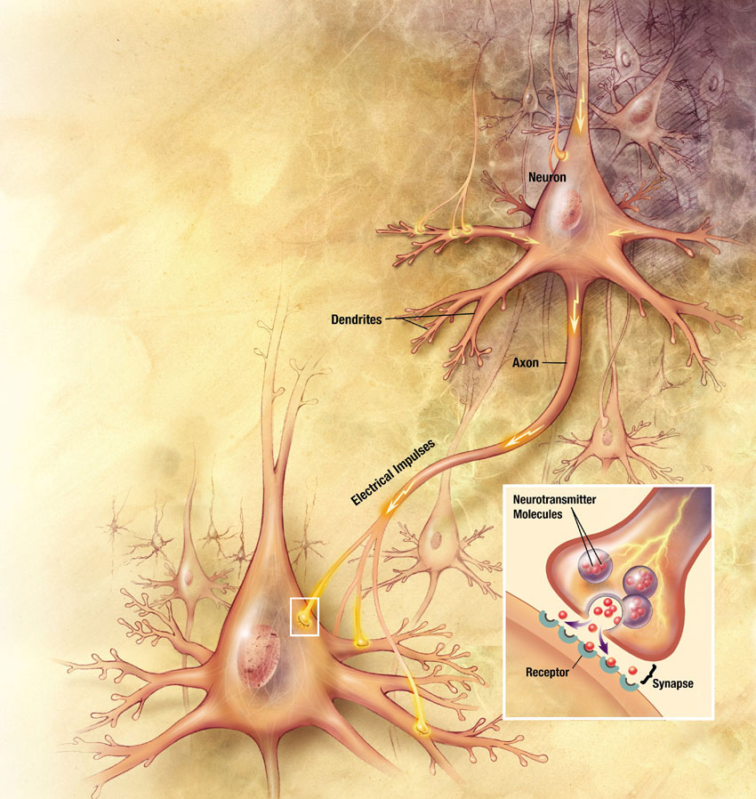
Relationships & Neurotransmitters
Serotonin
Dopamine
Epinephrine
Norepinephrine
GABA

Slide 25
Rapport Killers: The Dangers of Over/Under Estimating
Frustration - Effort
Impatience - Time
Disappointment - Capability

Slide 26
Science of Alliance
Carl Rogers
Know Your Students, Individualize
Eye Contact/Level, Smile, Call by Name
Speak Calmly, Simply & Clearly
Consistent, Congruent & Authentic
Validation, Reassurance, Reinforcement
Be Kind & Compassionate
Stay Positive
Maintain Boundaries – Don’t Take Personally

Slide 27
Teach, Reinforce, Practice, Promote & Model
Teach rather than assume…..
Appropriate Student Classroom Behavior
Self Regulation – Attention, Mood, Behavior
Hot & Cool EF, Engagement
Compliance
Pro-Social Behavior
Flexible Thinking
Mistakes & Recovery in Risk-Free Environment
Stress Management

Slide 28
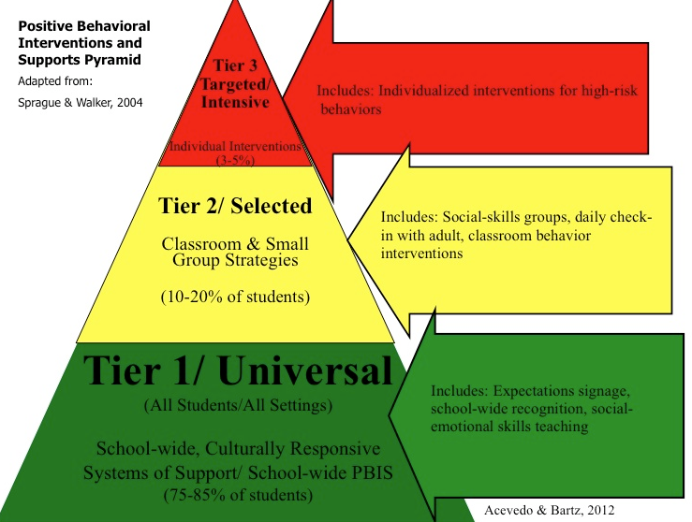

Slide 29
PAXIS Institute
Dr. Dennis Embry

Slide 30
Some Learner-Focused Approaches
Social Media
Create Media, PSA’s
Debate
Games
Brainstorming
Case Study
“Jigsaw”
Discovery
Small Cooperatives
Presentations
Role Play
Simulation
Role Play
Projects
Demonstration
Lab, Experiment
Panel/Expert/Q&A

Slide 31
Early Childhood & Preschool

Slide 32
Access to School-Based Mental Health Intervention & Prevention Services

Slide 33
Trauma Informed School Discipline Policies
Avoid exclusionary practices. Develop alternatives to out-of-school suspensions, expulsions.
Implement School-Wide PBIS
Approach discipline with the assumptions:
Behavior is product of past experiences, good & bad
Not “what’s wrong with you, rather what has happen to you”
Children do the best they can with what they have
Training in de-escalation & redirection as first line response
Form relationships: Student & Caregivers
Avoid “criminalizing”
Promote consistency and safety when enforcing
Work to prevent future behavioral problems, teach, promote, practice

Slide 34
Recommendations
Legislation & Policy, ESSA & State Plans
Hiring, Training, Professional Development
Frameworks, PBIS, PAX, Trauma-Informed
Avoid Re-Traumatizing
Revise School Discipline Policies
Parent Engagement
Community Partnerships
Teacher Resiliency & Self Care

Slide 35
Elite Pro’s Require Deliberate Acts of Self-Care
Physical: eat & sleep right, exercise, massage, time off, dance, sports, sex, limit screen-time, wear clothes you like
Psychological: meditate, yoga, stress management, journaling, literature & theories, be curious
Emotional: relationships, positive/praise, laugh, comforts
Spiritual: pray, meditate, sing, community, be inspired
Workplace: breaks, quiet time, chat, set limits, arrange space, peer support, supervision
Balance: work, family, relationships, play & rest

Slide 36
TCallahan@GreeneESC.org

