Slide 1
Center for Teaching, Leading and Learning
OCTEO Conference ∙ October 25, 2019

Slide 2
Updates
Educator Licensure and OAE Testing
Substitute Teaching Licenses
Licensure Code of Professional Conduct
Teacher Leadership
Culturally Responsive Practice
Human Capital Resource Center
Social and Emotional Learning Standards
Educators Rising
Ohio Teacher Evaluation System
Other

Slide 3
Educator Licensure
New Licenses and Endorsements
New OAE Licensure Tests

Slide 4
Licensure Grade Band Changes
PK-5 Primary and
PK-5 Primary Intervention Specialist Licenses
Available for Ohio colleges to e-sign beginning spring 2020
Phase-out issuing PK-3 ECE and PK-3 ECIS licenses on June 30, 2024

Slide 5
New: PK-5 Primary and
PK-5 Primary Intervention Specialist Licenses
New P-5 APK OAE Test
New P-5 Primary OAE Test
New P-5 Primary IS OAE Test
Notes:
OAE: Ohio Assessment for Educators
APK: Assessment of Professional Knowledge
IS: Intervention Specialists

Slide 6
New OAE Assessments Coming
Multi-Age Computer Information Science License
APK OAE (004) is required
Computer Science OAE (010) is required
New Computer Science OAE (054) Test will replace the OAE (010) Test

Slide 7
New OAE Assessments Coming
Multi-Age Computer Science Endorsement
New Computer Science OAE (054) Test is being recommended
Multi-Age Drama/Theater Endorsement
Current Theater OAE (048) Test is being recommended
Multi-Age Media Arts Endorsement
No OAE Test is being recommended

Slide 8
Substitute Teaching Licenses
New Substitute Teaching licenses will be issued to individuals who holds a post-secondary degree in either education or a subject area directly related to the subject of the class the license holder will teach, the individual may teach for an unlimited number of days.
http://education.ohio.gov/Topics/Teaching/Licensure/Audiences/Substitute-Licensure
Notes:
New Substitute Teaching License (1 Year or 5 Year)
Applicants will select teaching field(s) based on the post-secondary degree(s) they hold.
Post-secondary degree in Education:
Issued with a teaching field of “Education Degree-Unlimited.”
Valid for teaching unlimited days in a specific class in any subject or grade level, including intervention specialist areas.
Post-secondary degree in a subject related to an area of licensure:
Issued with a teaching field in a designated subject area related to the post-secondary degree (e.g., Integrated Mathematics). Review the list of subject areas available here.
Valid for teaching unlimited days in the designated subject area in any grade level.
Valid for teaching one semester in a specific class in other subjects with local board approval.
Post-secondary degree in a subject unrelated to any area of licensure:
Issued with a teaching field of "General Substitute."
Valid for teaching one semester in a specific class at any grade level with local board approval (the employing Ohio school board must approve extended assignments).
For individuals who are limited to one semester in a specific class, the local board of education may approve additional subsequent semesters in the same class.
Career-Tech Workforce Development (CTWD) – The district e-signer must electronically approve the online application to verify that you have the necessary skills and/or education to serve in the teaching field requested. Be sure to indicate in the application which Ohio school district or career center your application is to go to for electronic approval. Review the list of CTWD subject areas available here.
Reminder: Substitute teaching licenses are for substitute teaching. Substitute licenses do not meet proper certification requirements as required in Revised Code section 3319.074.

Slide 9
Office of Professional Conduct
#ABConduct Tip Sheets
Update of Licensure Code of Professional Conduct for Ohio Educators

Slide 10
#ABConduct
http://education.ohio.gov/ABConduct
Notes:
Proactive tip sheets to help navigate grey areas of professional conduct
Joint effort with the Ohio Education Association and Ohio Federation of Teachers

Slide 11
#ABConduct Topics
Social Media
Extracurricular leaders
Dollars and Sense
Drugs and Alcohol
Classroom Management
Top 10 Professional Conduct Concerns
Testing and Academic Integrity
Rapback and Applications
Broken Contracts
Educational Leaders

Slide 12
Licensure Code of Professional Conduct for Ohio Educators
Licensure Code has been updated
Proposed updates:
Ninth principle surrounding the use of technology
Defines grooming and academic dishonesty
Clarifies accurate reporting requirements
Adding nepotism and sexual harassment

Slide 13
Licensure Code of Professional Conduct For Ohio Educators
A draft of the proposed Licensure Code can be found at: education.ohio.gov/LicensureCode

Slide 14
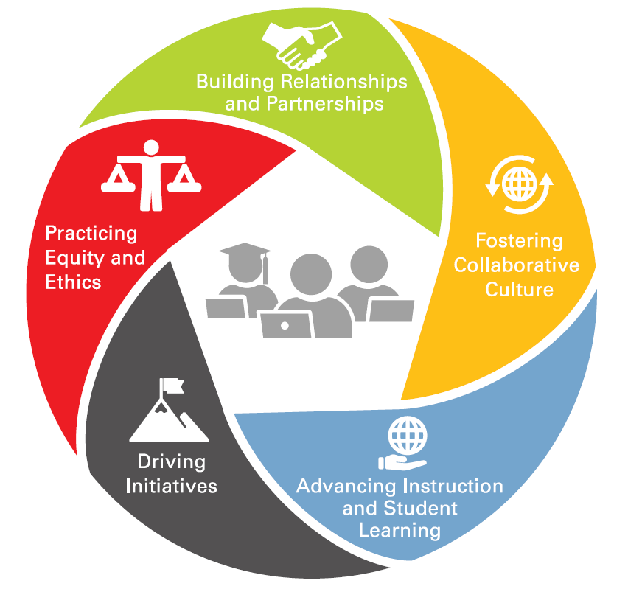
Teacher Leadership
Essential Work:
Teacher-in-Residence
Teacher Leader Liaisons
Teacher Leadership Toolkit
Teacher Leadership Summit
http://education.ohio.gov/Topics/Teaching/Teacher-Leadership
Notes:
When teacher leadership occurs in schools, positive effects extend to the teacher leaders, to their colleagues, and, most especially, to the students. –Angelle & DeHart, 2016
Teacher leaders hold the expertise to lead and expand the professional learning opportunities and supports available to fellow educators, enabling them to strengthen the profession and enhance student success.
Fostering Collaborative Culture:
Teacher leaders ground their work in mutual trust and clear communication with
colleagues, administrators, students, and families. Teacher leaders use effective interactions among colleagues that engage different back- grounds to respond to challenges and build consensus.
Advancing Instruction and Student Learning:
Teacher leaders advance teachers’ instructional practices and student learning by sharing research on best teaching practices, leading the use of data to inform and guide instructional decisions, and by engaging their colleagues in reflective dialogue.
Driving Initiatives:
Teacher leaders actively identify challenges/areas for improvement and innovation in the school, district, and state/national educational landscape.
Practicing Ethics and Equity:
Teacher leaders foster a positive and inclusive culture that seeks to understand students’ needs and respect the uniqueness of individual students and champion cultural competency and culturally-responsive practice.
Building Relationships and Partnerships:
Teacher leaders create and build strategic relationships and partnerships with colleagues, families, administrators, community members, public officials, higher education, etc. to address immediate and future needs of students, colleagues, school, their profession, and their community.
Teacher Leadership Toolkit:
A toolkit of resources and case studies to further help districts and schools with teacher leadership implementation is being developed for release next spring/early summer.
Teacher Leadership Summit
The summit brings together teachers, administrators, higher education faculty and organizations doing innovative work to develop teacher leaders. Attendees share successes, lessons learned and strategies for overcoming challenges in implementing teacher leadership.
June 10, 2020, Columbus, Ohio
ODE released an Ohio Teacher Leadership Toolkit at the end of September. The toolkit has resources and tools that may be helpful to Teacher Leader Endorsement preparation programs.
The toolkit can help districts identify their teacher leadership goals, choose strategies to initiate or advance teacher leadership in their districts, and reflect on current teacher leadership strategies as they build on that success.

Slide 15
Teacher Leadership
One-year Teacher-in-Residence at the Ohio Department of Education
Mona Al-Hayani, 2019 Ohio Teacher of the Year, Social Studies teacher from Toledo Early College High School.
She will promote:
-Teacher voice
-Teacher leadership
-Teacher recognition
Notes:
Mona Al-Hayani 2019 Ohio Teacher of the Year is stepping into a new role as the 2020 Ohio Teacher Fellow at the Ohio Department of Education. She will serve for one year in this role. During, the one-year sabbatical from her teaching assignment as a history teacher at Toledo Early College High School, Al-Hayani will promote teacher voice, teacher leadership and better recognizing teachers statewide. In addition to teaching, Al-Hayani has been the director of Human Trafficking and Social Justice issues for the Toledo Federation of Teachers for five years. She also is the chair of the School Education subcommittee for the Lucas County Human Trafficking Coalition. She will continue to focus on human trafficking prevention education as part of her fellowship.

Slide 16
Culturally Responsive Practice https://ohiohcrc.org/crp
Introduction to Culturally Responsive Practice
Cultural Responsiveness Socio-Political Awareness
Academic Achievement
Notes:
Culturally responsive practice is an approach that encompasses and recognizes both students’ and educators’ lived experiences, culture, and linguistic capital. The Ohio Department of Education will be hosting four courses to inform educators and support their efforts to include culturally responsive practice in their instruction.
ODE developing with Westat
Ready in late fall
Audience is pre-service and in-service educators
Focus on: cultural responsiveness, sociopolitical awareness, & academic achievement

Slide 17
Human Capital Resource Center
Tagline: Resources to Attract, Hire, and Support Excellent Educators in Ohio
Four Key Areas:
Notes:
Web toolkit
Exploring the Education Profession
Educator Recruitment
Mentoring
Professional Conduct
Educator Recognition

Slide 18
K-12 Social and Emotional Learning Standards
Adopted by State Board of Education in June 2019
Voluntary standards used to support students
Will not be assessed by state or used for accountability purposes
http://education.ohio.gov/Topics/Learning-in-Ohio/Social-and-Emotional-Learning
Notes:
In Each Child, Our Future, Ohio’s strategic plan for education, social-emotional learning is one of four equal learning domains supporting Ohio’s goal of preparing each student in Ohio for postsecondary life. Through a stakeholder-driven process, Ohio teachers, school counselors and education personnel developed Ohio's Social and Emotional Learning Standards for grades kindergarten through 12. The new K-12 Social and Emotional Learning Standards, adopted by Ohio’s State Board of Education, are posted on the Social and Emotional Learning Standards page. The standards aim to develop the “whole child” by helping students build self-awareness, social awareness, self-management, and relationship and responsible decision-making skills. Use of these standards is not mandatory but will serve as a voluntary resource for Ohio schools. The Ohio Department of Education will not develop or require assessments to measure students’ progress in learning skills outlined in the standards. Instead, schools and districts will have flexibility in using the standards and deciding whether and how to gauge the extent to which students are demonstrating progress. The Social and Emotional Learning Standards will not be used for district and school accountability purposes. The Department is developing free, online, customizable tools for districts, buildings and teachers to use in schools across grades K-12, as well as with parents and community members. As they are developed, the Department will post these resources here. Adopted by State Board of Education in June 2019
New! K-12 Social and Emotional Learning Standards
Social and Emotional Learning Standards
SEL is the process of developing and using the skills, attitudes, behavior and knowledge that help youth and adults:
Identify and regulate emotions
Develop positive relationships
Make responsible decisions
Ohio Educators and practitioners were part of an advisory group and writing teams that drafted the new standards over the course of a year
Organized in five competencies, Self-awareness, Self-management, Social awareness, Relationship skills, Responsible decision-making
Organized by grade band, standard statements are skills in place by the end of the grade band
In June, the State Board of Education adopted social and emotional learning standards for Kindergarten through Grade 12
Standards are voluntary to implement, with each public school district determining their use and implementation of the standards
For resources to support implementation, check out our webpage: http://education.ohio.gov/Topics/Learning-in-Ohio/Social-Emotional-Learning-Standards
Voluntary standards used to support students
Will not be assessed by state or used for accountability purposes
Resources at education.ohio.gov; Search keywords: social and emotional learning

Slide 19
A student organization for middle and high school students interested in entering the teaching profession.
Colleges are partnering with local schools and districts to grow existing chapters with the goal of creating a pipeline of educators from high school through college, to the classroom.
Notes:
Currently 70 co-curricular chapters and 4 club chapters exist in Ohio.

Slide 20
Ohio Teacher Evaluation System
Timeline
Prototype
Spring 2019
2) Pilot
2019-2020
3) Implementation
2020-2021
The teacher evaluation process remains unchanged for 2018-19 and 2019-20
Notes:
Last spring during the prototype phase, over 280 educators gathered on three separate occasions around the state to provide feedback to help inform the Pilot.
The purpose of the 2019-20 Pilot is to give districts and community schools an opportunity to implement the revised draft OTES on a broader scale and provide feedback to the Department before statewide implementation in the 2020-2021 school year.
Currently we have 77 pilot participants, included are Districts, Community, Schools and ESC’s
.

Slide 21
OTES: What has changed?
Current OTES​
Growth model​
50% Teacher Performance​ 50% Student Growth Measures or​ Alternative Framework option​
2 Formal Observations​ Walkthroughs​ ​
Teachers categorized as A, B, C​
eTPES ​
Revised Draft OTES​
Renewed emphasis on growth​
No more 50/50 ​ HQSD embedded in rubric ​ No Alternative Framework​
2 Formal Observations​ Walkthroughs​ Focused to Support Growth​
Teacher Categories no longer required​
OhioES​
Notes:
What has changed?
OTES 2.O will focus on educator growth, professional development and coaching by focusing on educator performance and use of data.
OTES 2.0 will not have the separate 50% component for student growth.
High Quality Student Data (HQSD) is focused on the assessment used by the teacher and the teachers use of the data gathered from the assessment.

Slide 22
Other
Ohio Latino Education Summit
November 8, 2019 at Kent State University
https://www.kent.edu/oles
Inclusive Education Leadership Institute
November 20-22, 2019 Columbus, Ohio
https://conference.ocali.org/
Notes:
Ohio Latino Education Summit
Registration is open for the 2019 Ohio Latino Education Summit, Inspiring ReSílience: Equity, Partnerships and Quality Schools, on Nov. 8 at the Kent State University Student Center Ballroom in Kent. This all-day event is hosted by the Ohio Commission on Hispanic/Latino Affairs in partnership with Kent State University and the Ohio Department of Education. The Summit equips educators, counselors, administrators and community leaders with the tools required to best serve Ohio’s Latino students. For general information and to register, visit the Ohio Latino Education Summit webpage.
Special Education Leadership Institute at OCALICON
The nation’s premier autism and disabilities conference:The Special Education Leadership Institute at OCALICON now is the Inclusive Education Leadership Institute and offers an expanded platform for general and special education leaders to collaborate, share research and inspire change for each child. The event provides a forum for leaders to develop a system of coordinated partnerships that support and address the needs of the whole child. Entrance to the Inclusive Education Leadership Institute is included with OCALICON 2019 conference registration, Nov. 20-22 in Columbus. Highly Qualified Teachers (HQT): Properly Certified or Licensed Teachers
Previous HQT Forms are no longer required by districts and community schools. Proper certification and licensure requirements have replaced HQT. Districts may use the ESSA State Licensure Assurance report within EMIS to verify properly certified or licensed requirements and/or identify conflicts relating to the requirements.

Slide 23
Center Contacts
Carolyn.Everidge-Frey@education.ohio.gov
Sherry.Birchem@education.ohio.gov
Yenetta.Harper@education.ohio.gov
Thomas.Mcgee@education.ohio.gov
Melissa.Weber-Mayrer@education.ohio.gov
Aaron.Ross@education.ohio.gov

Slide 24
education.ohio.gov

Slide 25
Join the Conversation
OHEducation
@OHEducation
@OHEducationSupt
OHEducation
OhioEdDept
education.ohio.gov/text

