Slide 1
Fostering Leadership through GRIT!
Youngstown State University
Notes:
MLD

Slide 2
A Gritty Reality...IT WORKED!
Penguin assistants for student success
Notes:
MLD

Slide 3
Introductions:
Dr. Mary Lou DiPillo, Associate Dean, Youngstown State University
Kristen Italiano, Project PASS Coordinator
Janet Donofrio, Literacy Coordinator for Youngstown City Schools/Liaison for Project PASS
Stephanie Davis, Teacher Candidate/Program Tutor
Maria Wilaj, Teacher Candidate/Program Tutor
Notes:
MLD

Slide 4
Sometimes the stars align…
CAEP Standard 2 for Selected Improvement Plan
Candidates have multiple opportunities to develop, practice, and demonstrate evidence-based pedagogical practices that improve student learning and development.
State mandates on field experiences
Ohio Administrative Code 3301-24-03
BCOE goal of effective, classroom ready teachers on the first day
Youngstown City Schools District needs
Notes:
MLD

Slide 5
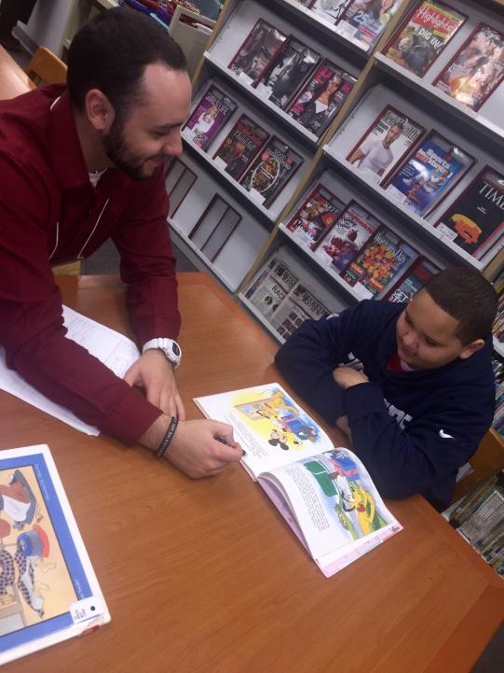
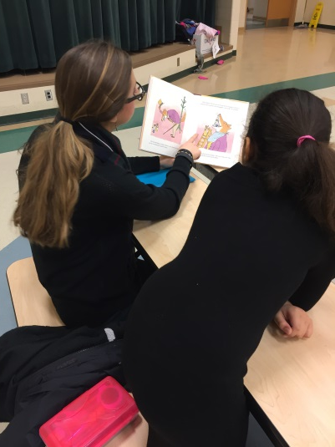
How does Project PASS WORK?
30 hours per semester
1 tutor to 2 YCSD students
Rapport based
Individualized
6 YCSD buildings
Grades 2,3,4
Non-academic times
Common areas
Utilizes strategies from literacy courses
Notes:
KI

Slide 6
Fast facts on Project PASS:
Semester | Number of YSU Tutors | Number of YCS Students | Hours of Tutoring
Spring 2015 | 267 | 288 | 8,640 hours
Summer 2015 | 79 | 94 | 2,880 hours
Fall 2015 | 290 | 278 | 8,340 hours
Spring 2016 | 315 | 416 | 9,450 hours
Summer 2016 | 29 | 95 | 110 hours
Fall 2016 | 262 | 555 | 7,960 hours
Spring 2017 | 275 | 526 | 8,000 hours
Total | 1,517 | 2,252 | About 50,000 hours

Slide 7
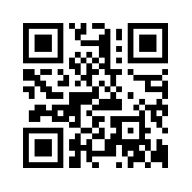
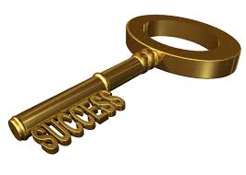
http://projectpass.weebly.com
Communication is KEY:
Project PASS website
Remind text alerts
Office/ Graduate Assistants
BCOE Newsletter
Emails
Google docs/ surveys/ forms
Anecdotal records
Information boards
Professional development sessions
Onsite monitoring
Meetings with YCSD administrators/teachers
Meetings with YSU Literacy Faculty
Notes:
KI

Slide 8
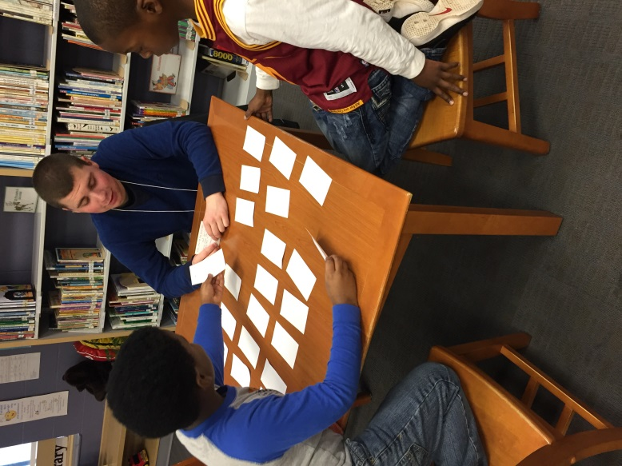
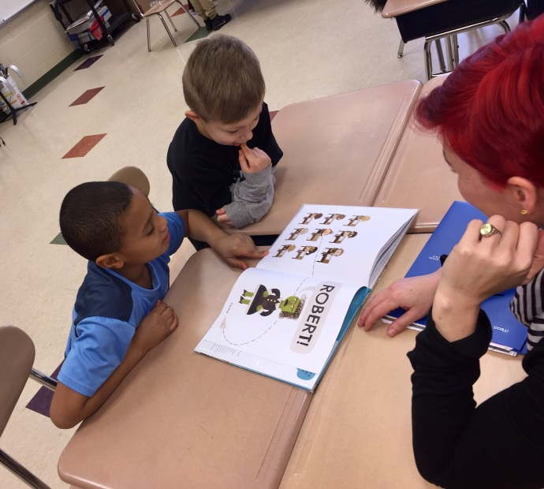
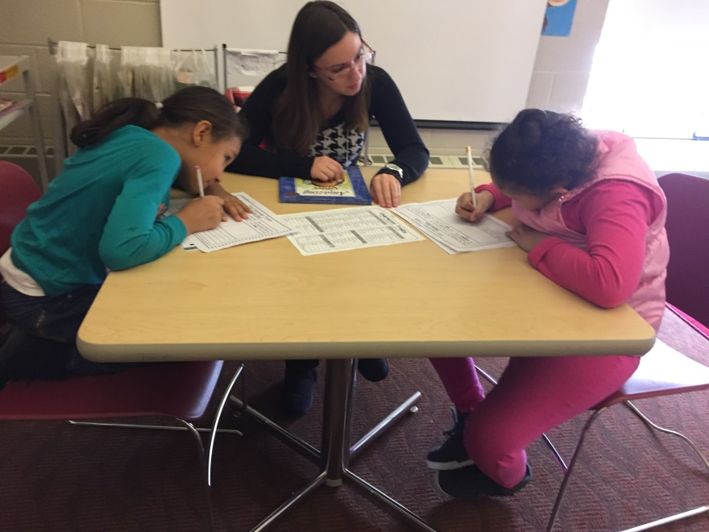
Tutoring sessions are:
Hands on
Student centered
Evidence driven
Need based
Meaningful
Relevant
Focus on fluency, comprehension and writing
Notes:
KI

Slide 9
Professional Development Sessions:
Offered monthly
Focus on best practices, student needs, hands-on learning
Count towards fieldwork requirements
Data based Exit Slips
Resources are shared though the partnership
Notes:
KI

Slide 10
The Evolution of Project PASS Professional Development Sessions:
From GRIT to GREAT with the help of PDs
PD topics include:
The basics of Literacy Collaborative
Interactive read alouds
Depth of Knowledge and fostering higher order thinking
Grit, Mindset and Determination
Writing with a mentor text
Impacting student learning and data analysis
Tiered vocabulary instruction
Hands on literacy centers
Notes:
KI

Slide 11
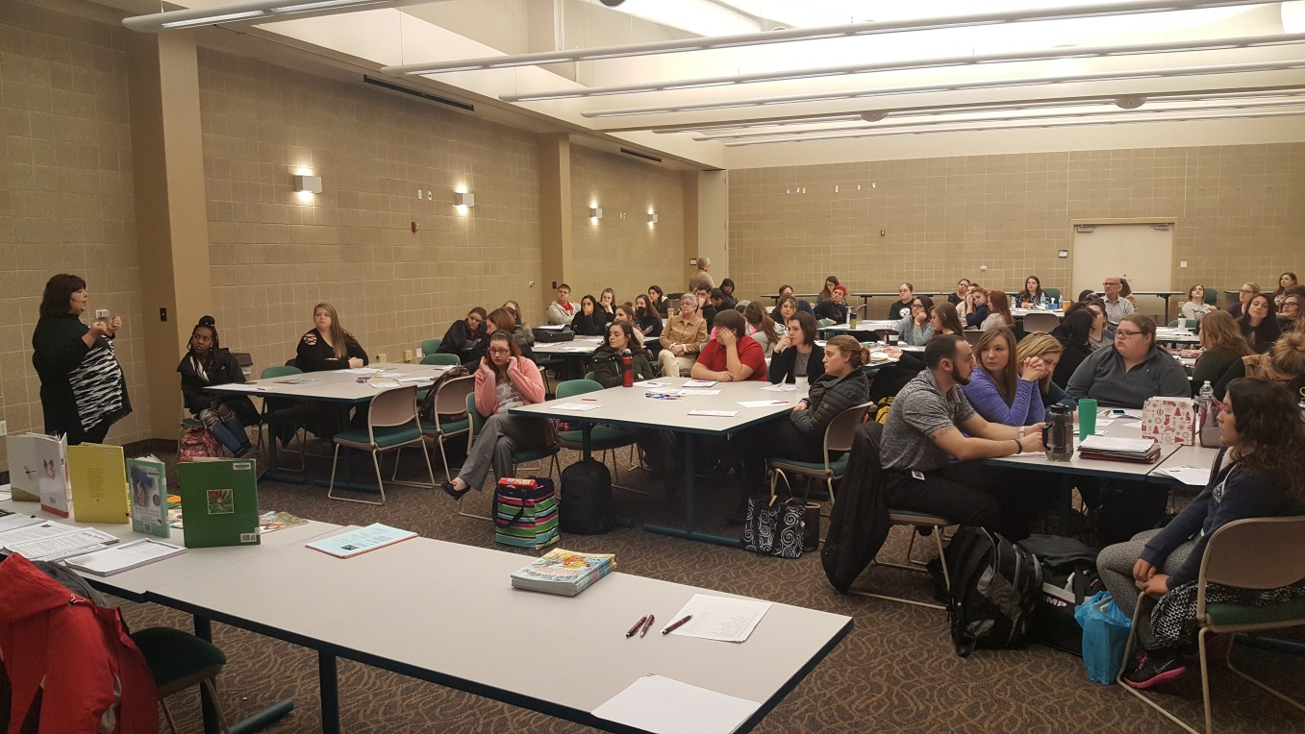
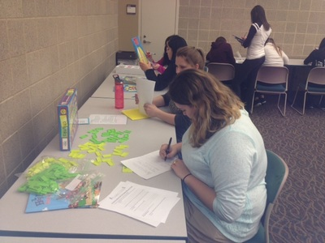
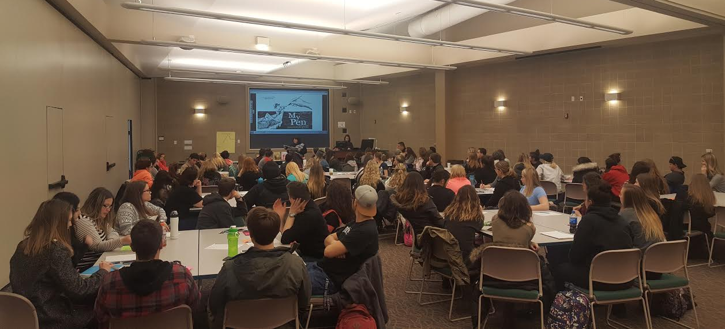
Professional Development
Notes:
KI

Slide 12
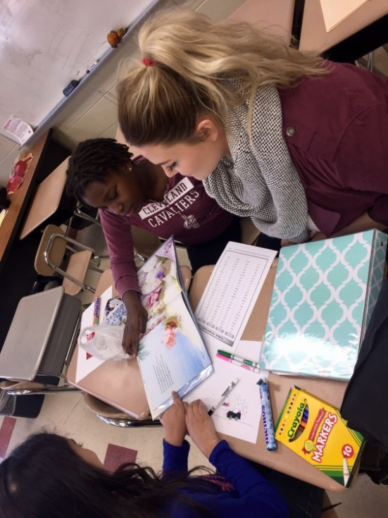
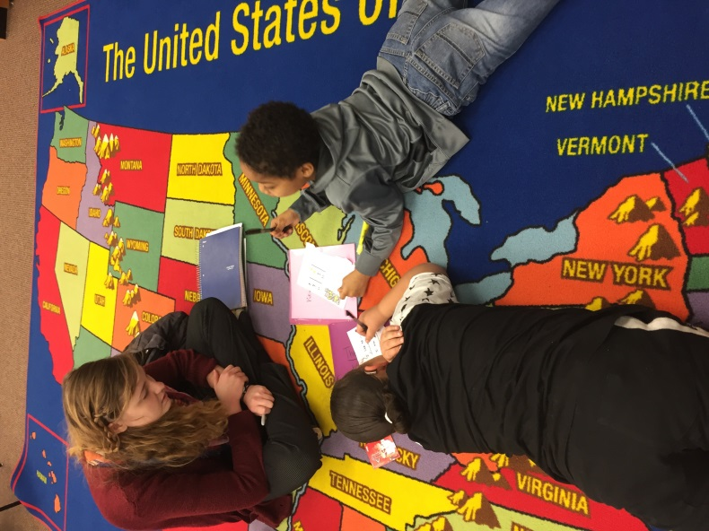
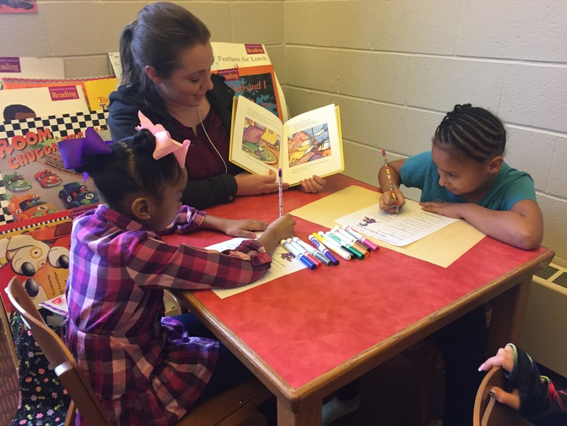
Tutoring with
Project PASS
Notes:
KI

Slide 13
How do the YSU teacher candidates feel…
Beginning
Unsure
Anxious
Middle
Teacher candidate growth
Student growth
End
Confident
Prepared
Notes:
S/M

Slide 14
Good things take time:
Rapport with Students
Building relationships
Fostering relationships
Maintaining relationships
Professional Confidence
Small group experiences in relation to whole group
Differentiation
Preparing for lessons & reflecting
Experience in different settings
Working with other professionals
(general ed. teacher, intervention specialist)

Slide 15
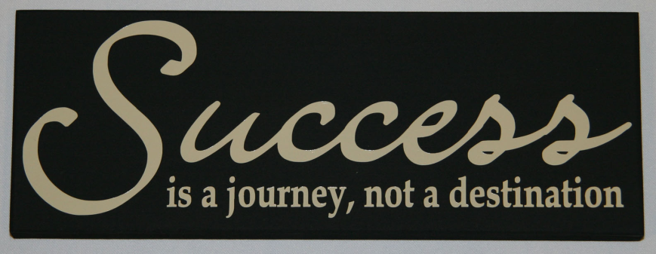
It’s the journey not the destination
Short Term Successes
Sticker Chart- Behavior Management
Academic Growth- Informal assessments
Long Term Successes
Motivation/Excitement of Learning
Improvement in Attendance/ behavior
Literacy in the Homes- Hog Mollie Books/Home Links
Overall Impact of Project PASS
Coherence to YSU Curriculum
Mutually Beneficial Relationships
Professionalism
GRIT

Slide 16
It has changed the way we think… and the way we teach…
Personal Investment
Working with students 2 to 3 times a week (sometimes twice a day)
Wanting our students to succeed
Students are comfortable working with tutors/ a true connection
Saying goodbyes at the end of a semester

Slide 17
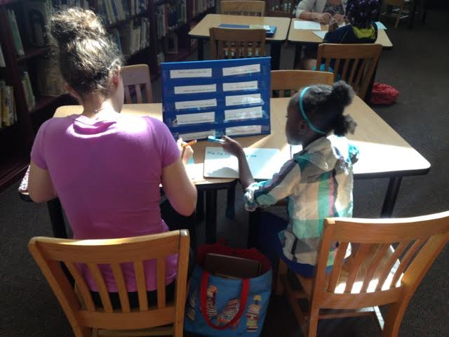
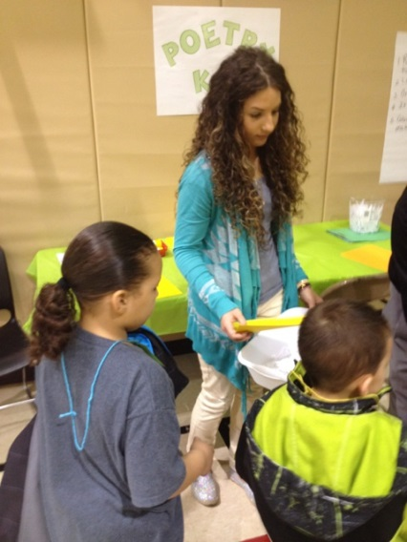
It is more than tutoring for our tutors
Being embedded in a school climate(depth/breadth)
Exposure and understanding of urban education
Building professional relationships within the schools
Participating in family literacy nights, school events and classroom projects
Knowing our student’s story has made all the difference
Notes:
S/M

Slide 18
Why Youngstown? Why now?
Since 2010, the Youngstown City School District has been in Academic Emergency based on its failure to meet state minimum targets for academic performance.
Facts:
YCSD created a Strategic Plan to address academic achievement
CEO takeover/ the “Youngstown Plan”
27.7% scored Proficient on the state test
YCSD has a student enrollment of 5,294
99.5 % of students enrolled are economically disadvantaged
Overall attendance rate is 91.7%
Chronic absentee rate of 29.4%
Mobility rate is 21.5%
Students with disabilities comprise 18.4% of the student population
Notes:
JD please share the academic background/ Demographics of YCSD

Slide 19
What is working…. What needs adjusted…
Successes in the beginning
Struggles in the beginning
EVALUATE/ MAKE ADJUSTMENTS
Current Successes
Current Struggles

Slide 20
A Liaison is NECESSARY for success
Needs as a START UP Program:
Access to class lists from YCS
Student benchmark data
Testing dates
Curriculum needs
School calendar
PD topics based of
district needs
Staff go between
Scheduling
Insight on specific building climates
Needs as a continuing Program:
Needs based PD support
District concerns or issues that may affect Project PASS tutors
Maintaining the longevity
Rapport with teachers
Transition of teaching staff and administrators
Using high quality practices in every tutoring session
Monitoring
Space
Project PASS is a marathon not a sprint… GRIT IS ESSENTIAL IN OUR SUCCESS
Notes:
JD

Slide 21
Where we started….
Youngstown City Schools adopted the Literacy Collaborative Framework from the Ohio State University.
It was decided that Project PASS tutoring sessions align with the framework established in the classrooms.
Professional Development was provided to the PASS tutors on specific best practices used in the Literacy Collaborative Framework –specifically the Interactive Read Aloud and Independent and Guided Writing.
Notes:
JD- how we try to align our needs with teacher needs and district framework/LC

Slide 22
What does the data show?
Ohio Education Research Center
External evaluator for Project PASS
A mutually beneficial partnership with mutually beneficial gains
Notes:
MLD

Slide 23
Logic Model:
Notes:
MLD

Slide 24
What was Evaluated:
Growth of YCSD 2nd graders on 3rd grade high stakes state assessment
Length students received a tutor
Professional development sessions
Literacy interventions used
Teacher/parent feedback through surveys
YCSD students surveys on behavior, reading growth, engagement
YSU teacher candidates’ literacy practices
Notes:
MLD

Slide 25
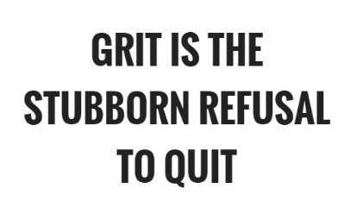
Evaluation of Project PASS:
Length of OERC Evaluation:
Spring of 2015-Fall of 2016
Method of evaluation:
Descriptive Statistics
Propensity Score Matching (TWIN MATCHING)
Qualitative coding
Purpose of the Evaluation:
What role does rapport and consistency play in academic growth?
Are we making a difference?
Are teacher candidates more prepared?
Did test scores go up?
Notes:
MLD

Slide 26
Hard work really does pay off!

Slide 27
What does it really mean?
OERC Spring 2016 RESULTS:
Medium to large effect
Students who participated in PASS during this semester were 54 percentage points more likely to meet the 3rd Grade Guarantee compared to similar peers who never participated in PASS.
Students who participated in Project PASS for 2 or more semesters were 41-51 percentage points more likely to meet the 3rd Grade Guarantee.
Grit got us GROWTH!
To view a full report of the evaluation click below https://drive.google.com/drive/folders/0B9dp_jtF7M45Umk2NEF2Nlk3OFU

Slide 28
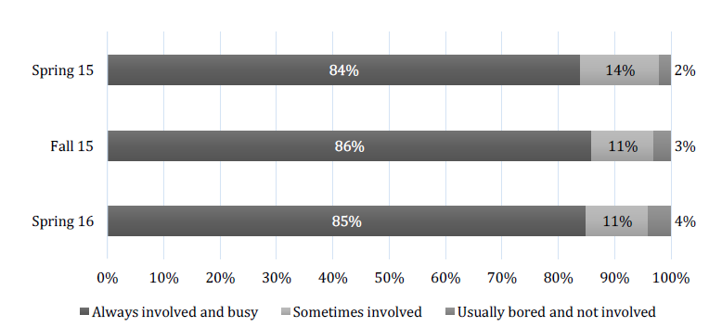
Evaluation: WHAT DID THE STUDENTS THINK??
Effects of Project PASS
Student report of engagement during tutoring
*Information and graphs are from OERC final evaluation. Data was collected through surveys administered to YCSD students.
Notes:
MLD

Slide 29
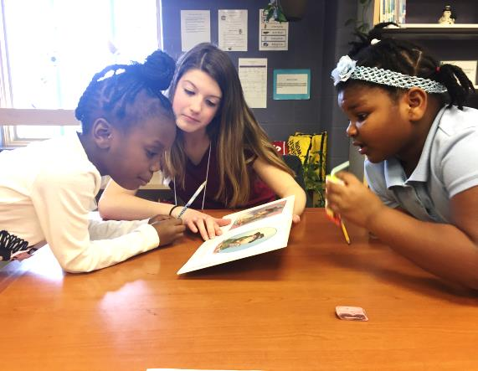
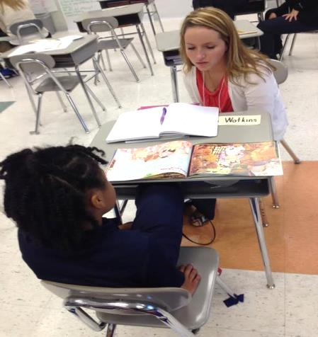
There is a story the data doesn’t tell
For YCSD students and YSU teacher candidates-
Meaningful relationships
Individualized attention
A sense of importance
A connection beyond academics
Consistency
Motivation/support
The opportunity to practice skills
Build confidence
Connect to a student
Understand an urban student
Emotional investment
Pride in the overall growth
Readiness for teaching
Notes:
KI

Slide 30
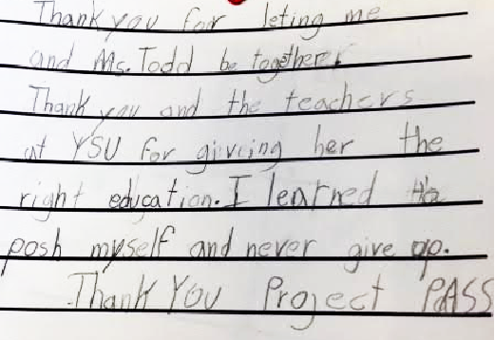
Penguin Assistants for Student Success
Notes:
KI

Slide 31
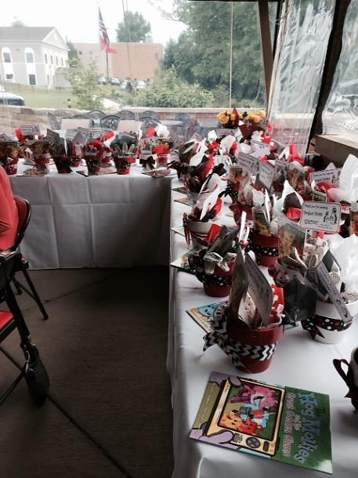
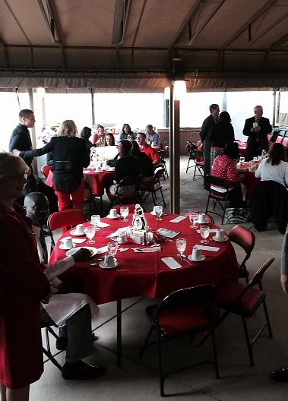
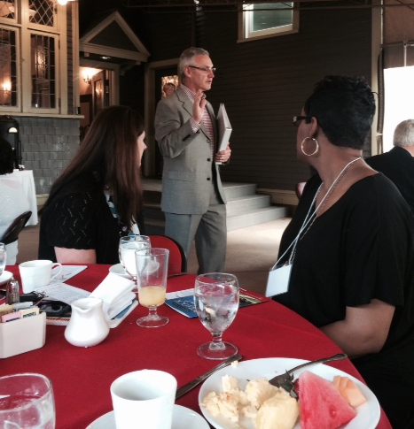
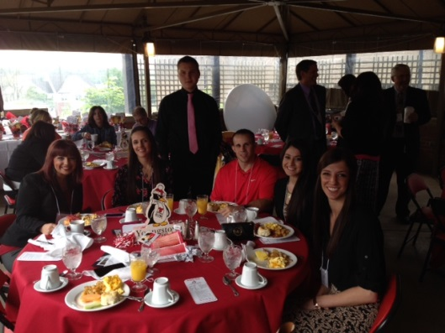
Motivate and Celebrate
Breakfast with President Tressel:
Notes:
KI

Slide 32
What’s next for YSU’s Project PASS?
Continue the Partnership with YCSD:
Sustain
Maintain
Adjust
Grow

Slide 33
What is so Gritty about PASS?
Sustaining the excitement
Celebrating small successes
Making adjustments in real time
Knowing that a difference is being made
Reevaluating the process and product
When the going gets tough,
we get Gritty!

Slide 34
GOT GRIT?

Slide 35
Project PASS
A Gritty Reality, IT WORKED!
Questions?

