Slide 1
Empowering Educators through Local, National, and Global Partnerships Ohio Confederation of Teacher Education Organizations (OCTEO) 2011 Spring Conference
Dr. Rosaire Ifedi, Educational Foundations
Dr. Donna Villareal, Inclusive Services & Exceptional Learners
Dr. Debbie Arrowsmith, Curriculum & Instruction- Literacy Specialist
Monica Carroll, Groveport Madison Middle School
Carrie Darr, Norwich Elementary, Hilliard City Schools

Slide 2
BACKGROUND & CONTEXT
Change : The One Constant
ODE - Ohio Educator Standards
ODE - Common Core State Standards
Teacher Efficacy NCATE Standards
New Ohio Teacher Licensure Standards
21st Century Learning
Global Comparisons

Slide 3
Ohio Standards For the Teaching Profession
“The research is clear: what matters most is the quality of the teacher we put before every student. It is the interaction between teacher and student that is critical to producing high level student learning and achievement (www.ode.state.oh)
1. Teachers understand student learning and development and respect the diversity of the students they teach.
2. Teachers know and understand the content area for which they have instructional responsibility.
3. Teachers understand and use varied assessments to inform instruction, evaluate and ensure student learning.
4. Teachers plan and deliver effective instruction that advances the learning of each individual student.
5. Teachers create learning environments that promote high levels of learning and achievement for all students.
6. Teachers collaborate and communicate with students, parents, other educators, administrators and the community to support student learning.
7. Teachers assume responsibility for professional growth, performance and involvement as an individual and as a member of to learning community.

Slide 4
Ashland University
Ashland University Mission
College of Education | Ashland University
Values: Knowledge, Accent on the Individual, Collaboration, Reflection, Ethics
Faculty-Led Programs | Ashland University

Slide 5
Coursework field experiences service & community research: graduates & faculty
Educator Preparation

Slide 6
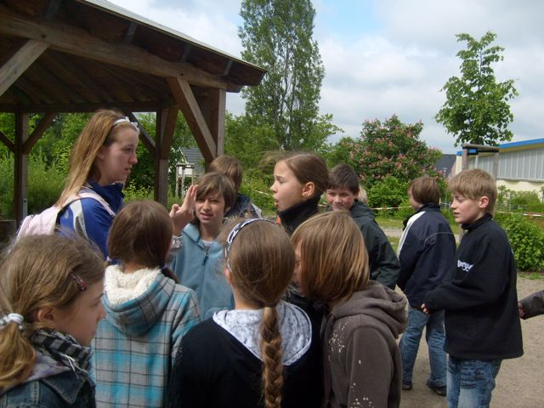
Field Teaching Experiences in Eastern Germany
International Partnerships

Slide 7
Local Partnerships
Reading Clinic
Partnering with Columbus City Schools
To think and act globally, we think and act locally.
Preparing and Empowering pre and in-service teachers for success across diverse learning environments.
Components include:
*Tutoring opportunities for students at below-grade level
*Targeted diagnostic and remediation training for AU students
*Parent and Guardian Involvement
*Sibling Component
* Diverse communities around Columbus Center

Slide 8
National Partnerships
Framework for 21st Century Skills
Teaching that encourages knowledge sharing among communities of practitioners, using face-to-face, virtual and blended communications" including:
Community guest speakers in classes
Field and student teaching experiences (IBO)

Slide 9
National Partnerships
http://scharspotlight.blogspot.com
Connecting coursework, field experiences and clinical preparation.
Closing gaps in course exposure and application in practice –diversity, special education, ELLs
(National Comprehensive Center on Teacher Quality and Public Agenda, 2008)

Slide 10
International Partnerships
Global Perspectives on Education
Inquiry Seminar Components include
Research on diversity, authentic assessments, literacy, special education, gifted education
School reform strategies
Interaction with diverse others
Blogging and Reflection

Slide 11
International Partnerships
Inquiry Projects in
London, England Classrooms

Slide 12
Educators’ Efficacy and Growth
Capstone Inquiry Project
“Gifted Education In the United Kingdom and the United States”
Teacher and teacher assistant
Project based/Theme based
Learning through experiencing, investigating
No gifted classrooms, all inclusion
No gifted labels, students not told
Students individually challenged with goals
After school/before school programs for talent or other gifted abilities

Slide 13
Teacher Efficacy & Learning
Student Engagement
Capstone Inquiry on Special Education
Similar legislation timing
Cultural differences, different beliefs
More nominations for identification
US ahead in programs
UK ahead in differentiation
More teachers involved in teaching gifted in UK, US has specially trained teachers
Stop global competition, start sharing

Slide 14
Advanced Field Practicum
Student-designed project in a special needs resource room.
Students with learning disabilities, autism, gifted and talented in one area. 11students, 8 boys;3 girls.
Site: Diverse-- socio-economic ally, free and reduced lunch; Caucasian, adoptive families, Russia, Mexico, and Africa; American citizens.
“I was unaware that I had students who spoke a different language at home.”
“My masters course work is changing the way that I do things in my classroom. I find that I am assessing my children in many different ways…not just when it comes time for report cards and their annual IEP meetings.”
The Assessment class opened my eyes to assessment formats that I might have been aware of, but had forgotten about and was not using in my classroom on a regular basis. I am taking ideas from classmates, professors, and educational settings visited, and applying these new ideas in my classroom. From London, I took the idea of Aspiration sheets and decided to focus on those as a means to motivate my students. We talked about where we want to go and how we are going to get there. These sheets now stay in each student’s binder as a constant reminder of what we are working towards.
With the aspiration sheets that I completed with my class, I had to reflect upon the purpose of such sheets and how to adapt for a special needs classroom and the confidentiality involved. I loved how the sheets were hung in the hallways of the school each student and help them to keep “an eye on the prize” so to speak and so I needed to have the students keep the paper in a place where he could easily find it when motivation was needed.
This project met the needs of every diverse student because of its individuality. Everyone has a dream, regardless of their diverse needs. It could be as plain or elaborate as the child wanted it to be. It was for their personal use. My only goal was for them to think beyond the moment. Everyone must feel as if what they are doing has purpose. That way, each student will be invested in what they are doing.
On a daily basis, I work with diversity in the way of academic functioning. Each of my students is at a very different spot and I have to adjust my lessons to meet the needs of students who can hardly read to the needs of students who are reading and writing almost on grade level. My assessment class helped me create tiered assessments for these learners. This class also helped me to adapt content area assessments for the special needs students.

Slide 15
Your thoughts? Thank You!
Affirming Teacher Identity
“Developing the ability to see beyond one’s own perspective, to put oneself in the shoes of the learner and to understand the meaning of that experience in terms of learning, is perhaps the most important role of universities in the preparation of teachers.” Prof. Linda Darling-Hammond (2000).

Slide 16
References
Abromitis, B. (2010). Partnering with parents through family literacy programs. Reading Today.
Ashland University. Studying Outside of the Classroom. Study Abroad Programs. Retrieved December 30, 2010, from http://www.ashland.edu/academics/studyabroadprograms
Brown, T. (1998). Family literacy: Respecting family ways. Reading Teacher, 261-271.
Darling-Hammond, L. (2000). How teacher education matters. Journal of Teacher Education, 51(3), 166,-174.
Johnson, D. P. (2005). Sustaining change in schools: How to overcome differences and focus on quality. Alexandria, VA: Association for Supervision and Curriculum Development.
National Comprehensive Center on Teacher Quality. (2008). Lessons Learned, 3
Oakes, J., & Lipton, M. (1999). Teaching to change the world. Boston: McGraw-Hill.
Ohio Department of Education. Ohio Standards for the Teaching Profession. Retrieved from www.ode.state.oh
Partnership for 21st Century Skills. Retrieved January 10, 2011 from www.p21.org
Saenz-de-Tejada, C., Kopischke Smith, T., & Moreno-Lopez, I. (2008). Language and study abroad across the curriculum. Foreign Language Annals, 41(4), 674-686.

